Slide 1
Lesson objective
TITLE: Whole number addition and subtraction
Aim:
I can explain commutative law
I am able to perform mental strategies and simple algorithms for addition and subtraction
Plan:
Finish our notes page
Practice using notes
Discuss communitive law
Large number algorithms

Slide 2
Inside: the important stuff
Same signs Add the numbers Answer is the same sign as the numbers E.g. | Different signs Subtract the numbers Answer is the same sign as the “bigger” number E.g. | Keep, change, change KEEP the first number the same CHANGE subtraction to addition CHANGE the sign of the other number Then follow addition rules E.g. 14 – (-3) ➔ 14 + 3 = 17 (demo number line) (-8) – 2 ➔ (-8) + (-2) = -10
Same signs Answer is positive E.g. | Different signs Answer is negative E.g. | Same signs Answer is positive E.g. | Different signs Answer is negative E.g.
What would happen if we multiplied 3 negative numbers?

Slide 3
Notes practice
I do
We do
11 + (-6) =
4 – (-5) =
(-6) – 5 =
(-5) – 13 =
14 + (-11) =
11 – (-9) =
(-8) – 5 =
(-11) – 8 =

Slide 4
Division and multiplication
I do
We do
3 x 5 =
(-4) x (-8) =
(-7) x 3 =
4 x (- 3) =
4 x 7 =
(-3) x (-5) =
(-6) x 6 =
9 x (-2) =

Slide 5
Whiteboard practice
4 + 9 =
7 + 11
(-5) + 7 =
20 + (-6) =
12 – (-5) =
6 – (-3) =
(-8) – 4 =
(-15) – 6 =

Slide 6
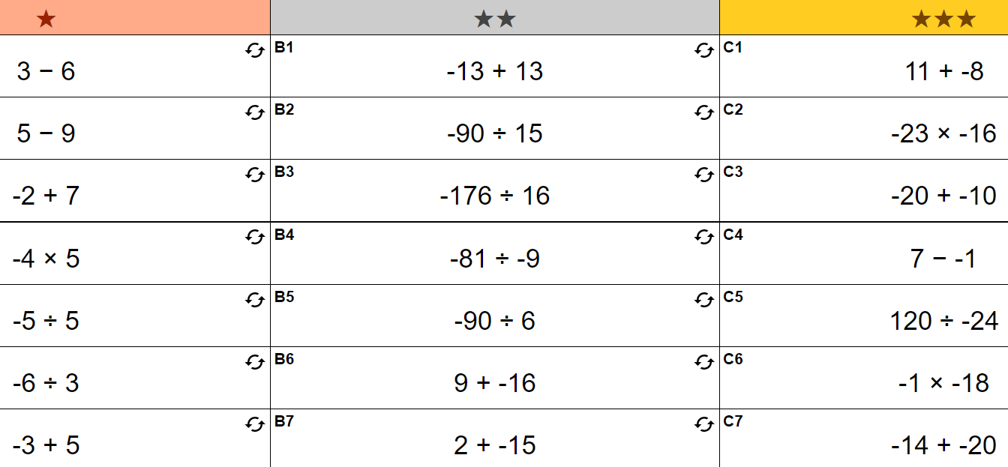
Individual practice: exercise book

Slide 7
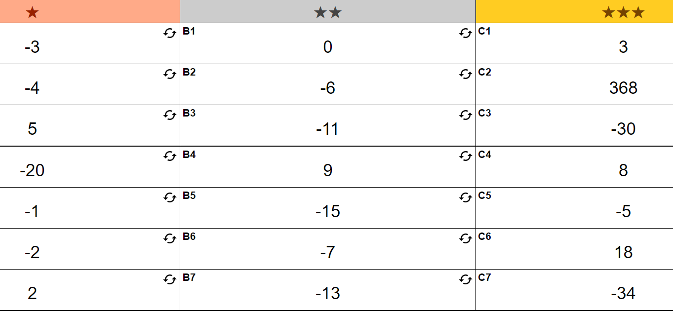
Answers

Slide 8
Commutative Law
Any finite sum or product is unaltered by reordering its terms or factors
Made simple:
Addition and multiplication are not affected if the order of the numbers are changed
Addition and multiplication are ___ affected if the order of the numbers are changed
Addition and multiplication are ___ affected if the order of the number are ______
What is not affected by changing the order of terms?

Slide 9

Commutative law examples
Addition
Multiplication
a + b = b + a
4 + 5 = 5 + 4
12 + 7 = 7 + 12
(a + b) + c = (c + b) + a
a x b = b x a
ab = ba
3 x 6 = 6 x 3
100 x 8 = 8 x 100

Slide 10

What is an Algorithm?
An algorithm is a process or a set of rules to be followed in calculations or other problem-solving operations.
We do it when we add, subtract, divide and multiply in mathematics and, computers do it when they perform functions.

Slide 11
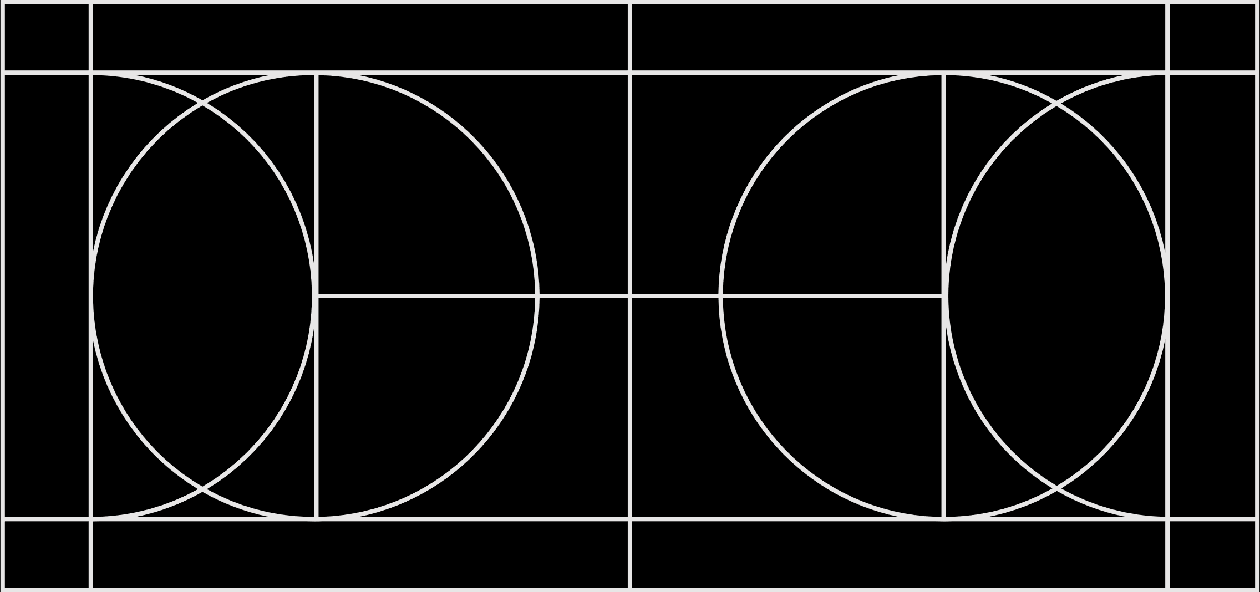
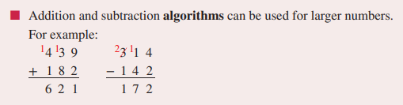
Large number algorithm
245
+ 156
245
- 136

Slide 12
Practice
I do
We do
467
+ 215
548
- 326
555
+ 234
784
- 563

Slide 13
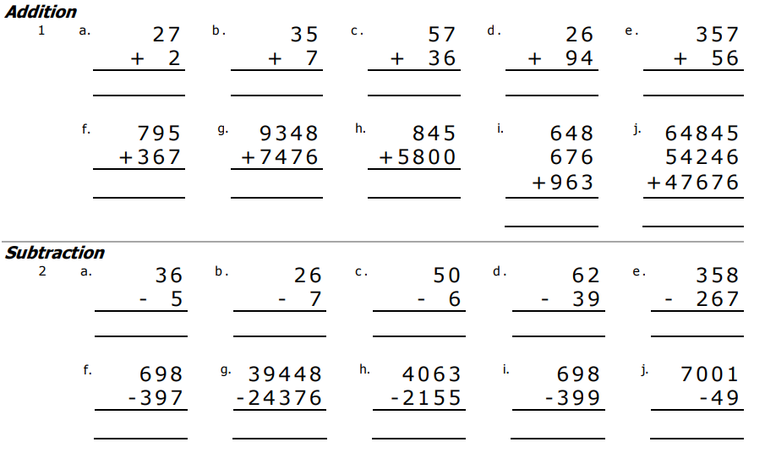
You do – exercise books

Slide 14
Mixed large numbers
2450 – (-145) =
560 + (-215) =
(-345) + 259 =
5480 + (-1438) =

Slide 15
How did we do?
Success criteria:
I can explain commutative law
I am able to perform mental strategies and simple algorithms for addition and subtraction

